Slide 1
Coding Club 2021 - Python Session 2
Computer Vision

Slide 2
1
Last Session Assignment Review (10 min)
2
Background and Theories (20 min)
Agenda
3
Coding Time
(60 min)
4
Assignment

Slide 3
Last Session Assignment Review (10 min)
Recap assignment
Sample solution
Q&A

Slide 4
Variables
counter = 100 # An integer assignment
miles = 1000.0 # A floating point
bool = True # A boolean (True or False variable)
name = "John" # A string (Can use both single and double quotation marks)
countries_list = [‘New Zealand’, ‘Australia’, ‘USA’] # A list, can also be made up of different data types
countries_tuple = (‘New Zealand’, ‘Australia’, ‘USA’) # Very similar to a list, but the brackets are round. The elements and size cannot be changed.
print (counter)
print (miles)
print (name)
print (countries_list[0]) # print the FIRST item in the list. What does print (list[2]) do?, or print (list[-1]) do?
# means a comment – you can write anything you want after a #, the program won’t read it
Both numbers, can also have Long integers, and complex numbers
print (???) tells the program to print what is in the brackets to the output window.
Notes:
Go through each variable type and printing them

Slide 5
Casting Variables
Duck Typing:
Some languages require you to state what data type a variable is before you use it. And specify all the variables at the top of the code.
Python just allows you to assign a variable a number or string, and assumes what data type it is from what you have written.
You can change from some data types to others:
number = 5 # An integer
text_number = str(number) # text_number is now 5, but in a string/text format. Adding it / subtracting it from another integer will not work
Number_again = int(text_number) # converting the string “5” back to a number 5 again
Notes:
Talk about how variables are assigned
Converting between variable types

Slide 6
Python Collections
There are four collection data types in the Python programming language:
List is a collection which is ordered and changeable. Allows duplicate members.
Tuple is a collection which is ordered and unchangeable. Allows duplicate members.
Set is a collection which is unordered and unindexed. No duplicate members.
Dictionary is a collection which is unordered, changeable and indexed. No duplicate members.
# Lists and Tuples
mylist = [‘abcd’, 786, 2.23, 1234, -5]
# Indexing (same for lists and tuples)
print (mylist[:]) # returns all values in the list
print (mylist[2:]) # returns the 3rd element of the list until the last
print (mylist[2:5]) # returns the 3rd to the 5th elements in the list
print (len(mylist)) # returns the length of the list
Notes:
Talk about different collection types in python
Discuss lists in detail (others to follow on next slide)

Slide 7
Python Collections
There are four collection data types in the Python programming language:
List is a collection which is ordered and changeable. Allows duplicate members.
Tuple is a collection which is ordered and unchangeable. Allows duplicate members.
Set is a collection which is unordered and unindexed. No duplicate members.
Dictionary is a collection which is unordered, changeable and indexed. No duplicate members.
# Sets and dictionaries
cars = {“Toyota”, “Ford”, “Subaru”} # A set is a collection which is unordered and unindexed.
person = {“name”: “John”, “age”: 45, “height”: 180} # A dictionary is a collection which is unordered, changeable and indexed.
person["age"] = 42 # Update the age
# Indexing
print ([car for car in cars]) # Can’t index sets directly since they are unordered, so must loop through them
print (person[“name”]) # returns John
print (person.keys()) # returns each of the dictionary keys (alternatively dict.values() returns all the values)
Notes:
Discuss sets and dictionaries:
- How to create them and their benefits

Slide 8
Python Collection Methods
For strings, lists, sets, dictionaries, and tuples there are different methods used to perform operations on them. Some common ones are shown below:
“Hello” + “ world” will join the two strings together (concantenate)
“,”.join(list_of_strings) will join the list to a strings and split each value by a comma
mylist.append(var) will append the variable var to the end of a list
mylist.sort() will sort a list
mydict.items() will return a list of tuples for each pair in the dictionary
set1.intersection(set2) will return the intersection of two sets.
These are just some examples of what can be done with collections in Python. Be sure to look online for more details!
Notes:
Talk through collection methods shown on screen

Slide 9
Basic Statements
A basic example script
import numpy # importing the numpy package
import pandas as pd # importing the pandas module, but letting you refer to it as pd instead of pandas
from matplotlib import pyplot as plt # importing the pyplot module, from matplotlib and name it plt
a = 20 # assigning a value to a variable called ‘a’
b = “hello” # assigning a string of letters to a variable called ‘b’
c = 0.04 # assigning a value to a variable called ‘c’
print (“hello”) # printing a string of letters
print (b) # printing the value of variable ‘b’ – will give the same output as the line above
print (a) # printing the value of variable ‘a’
Import statements
Assigning values to variables
Print statements
Notes:
How to import packages

Slide 10
Basic Statements – If statement
print (“example 1”)
a = 3 # giving ‘a’ an initial value of 3
if a <= 5:
b = a*2 # assigning a new value to ‘b’ as being 2 times ‘a’
print (b)
print (“example 2”)
a = 6 # reset value of ‘a’ to 6
if a <= 5:
b = a*2
print (b)
else:
print (“a is greater than 5”)
If statement:
if condition semicolon
Everything inside the if is indented four spaces.
Other condition statements can be “<“, “>”, “>=“, “==“, “in range(0,10)”, “in x”
Can add an else statement
Notes:
Recap on basic statements

Slide 11
Basic Statements – For loop
For statement:
“a in range (0,200)” means 0,1,2,….199
“a in c” give a each value found in c in turn
print (“example 3”)
a = 0 # giving ‘a’ an initial value of 0
for a in range (0,200):
b = a*2 # assigning a new value to ‘b’ as being 2 times ‘a’
print (b)
print (“example 4”)
c = (1,5,6,10)
for a in c: # this means assign a each value found in c in turn
b = a*2 # assigning a new value to ‘b’ as being 2 times ‘a’
print (b)
print (“example 5”)
for letter in “Python”: # takes each letter in the string “Python”
print (“Current Letter :”, letter) # prints the text “Current Letter:” followed by the value of variable “letter”
Notes:
Recap on basic statements

Slide 12
Basic Statements – While loop
While statement:
Continue doing something until the specified condition is no longer true. Then stop.
print (“example 6”)
a = 0 # giving ‘a’ an initial value of 0
while a <10:
b = a/2.0 # assigning a new value to ‘b’ as a divided by 2
print (b)
a = a+1 # need to update the value of a (otherwise loop will be never ending)
print (“example 7”)
a = 0 # giving ‘a’ an initial value of 0
sum = 0 # giving ‘sum’ an initial value of 0
while a <10:
sum = sum + a # assigning a new value to ‘sum’ as the original value of sum + a
print (sum)
a = a+1 # need to update the value of a (otherwise loop will be never ending)
Notes:
Recap on basic statements

Slide 13
Basic Statements – Defining Functions
def statement:
Def is used to define functions, which is a section of code to be reused
print (“example 8”)
# Define a function with inputs and outputs
def multiply(input1, input2):
result = input1 * input2
return result
multiply_result = multiply(10, 56) # returns a result of 560
Note that all variables defined in the function that are not returned at the end are only able to be accessed within the function!
Notes:
How to write a function
Define the name and inputs
Body of the function
Return a result
How to call the function

Slide 14
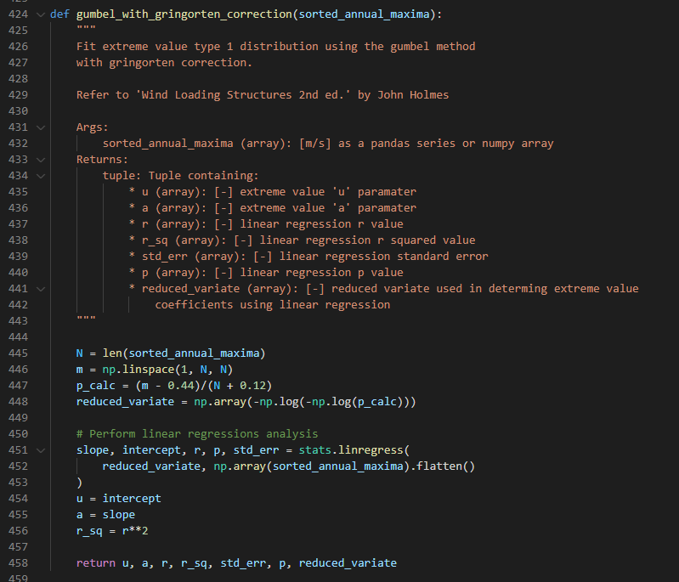
Documenting Functions
Typically called a ‘docstring’ and it goes at the beginning of a function to tell users the inputs, outputs and what it does.
Typical format that I use (can have other sections):
"""
Brief description of the function.
Args:
arg1 (type): [unit] description
arg2 (type): [unit] description
Keyword Args:
Karg1 (type): [unit] description
Karg2 (type): [unit] description
Returns:
tuple: Tuple containing:
* return_arg1 (type): [unit] description
* return_arg2 (type): [unit] description
"""
Notes:
Benefits of a docstring
Clear and detailed instructions for future use
Typical format that I use – with example
Discuss that three double quotation marks denote a multi-line comment
Can include different sections (e.g. Attention, Attributes, Example, References, Todo, etc.)

Slide 15
Coding Time (60 min refer to notebook)
Teaching points
Generic (in case new people join)
Print, input
Shortcut keys, run by row
Code, markdown, notebook and .py
Import library
Tab function and error handling
Session specific
Importing packages
Writing a function
Using a function
Accessing a third-party packages docstring
Complex if statements
Combined strings for files in the same path

Slide 16

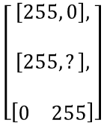
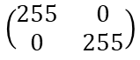
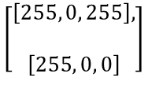
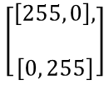
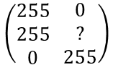
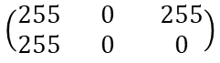
Background and Theories (20 min)
0
255
255
0
255
0
255
0
255
Graphical
255
0
255
255
0
0
?
0
255
Maths
$$\left(\begin{matrix}255 & 0 \\ 0 & 255\end{matrix}\right)$$
$$\left(\begin{matrix}255 \\ 255\end{matrix} \begin{matrix}0 \\ 0\end{matrix} \begin{matrix}255 \\ 0\end{matrix}\right)$$
$$\left(\begin{matrix}255 \\ 255 \\ 0\end{matrix} \begin{matrix}0 \\ ? \\ 255\end{matrix}\right)$$
$$\left[\begin{aligned}\left[255, 0\right], \\ \\ \left[255, ?\right], \\ \\ \left[\begin{matrix}0 & 255\end{matrix}\right]\end{aligned}\right]$$
Python Array
$$\left[\begin{aligned}\left[255, 0\right], \\ \\ \left[0, 255\right]\end{aligned}\right]$$
$$\left[\begin{aligned}\left[255, 0, 255\right], \\ \\ \left[255, 0, 0\right]\end{aligned}\right]$$
Shape
(2,2)
(2,3)
(3,2)
Row by column

Slide 17
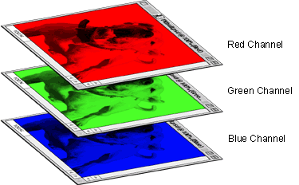

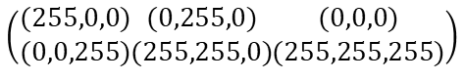
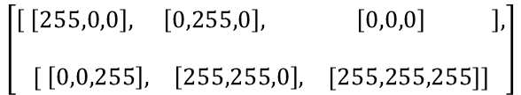
Background and Theories (20 min)
0
255
0
255
0
255
$$\left(\begin{matrix}(255,0,0) \\ (0,0,255)\end{matrix}\begin{matrix}(0,255,0) \\ (255,255,0)\end{matrix}\begin{matrix}(0,0,0) \\ (255,255,255)\end{matrix}\right)$$
(255,0,0)
(0,255,0)
(0,0,0)
(0,0,255)
$$\left[\begin{aligned}\left[ \begin{matrix}\left[255,0,0\right], & \left[0,255,0\right], & \left[0,0,0\right] \end{matrix}\right], \\ \\ \left[\begin{matrix} \left[0,0,255\right], & \left[255,255,0\right], & [255,255,255]\end{matrix}\right]\end{aligned}\right]$$
(255,255,0)
(255,255,255)

Slide 18

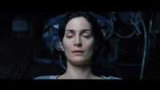

Background and Theories (20 min)
Resize
Convert Colour
Read / Write
Detect
Filter
Display
Manipulation based on academic research
Etc

Slide 19


Background and Theories (20 min)
Read / Write speed
Flexibility to manipulate
Powerful libraries with ongoing supports from community

Slide 20
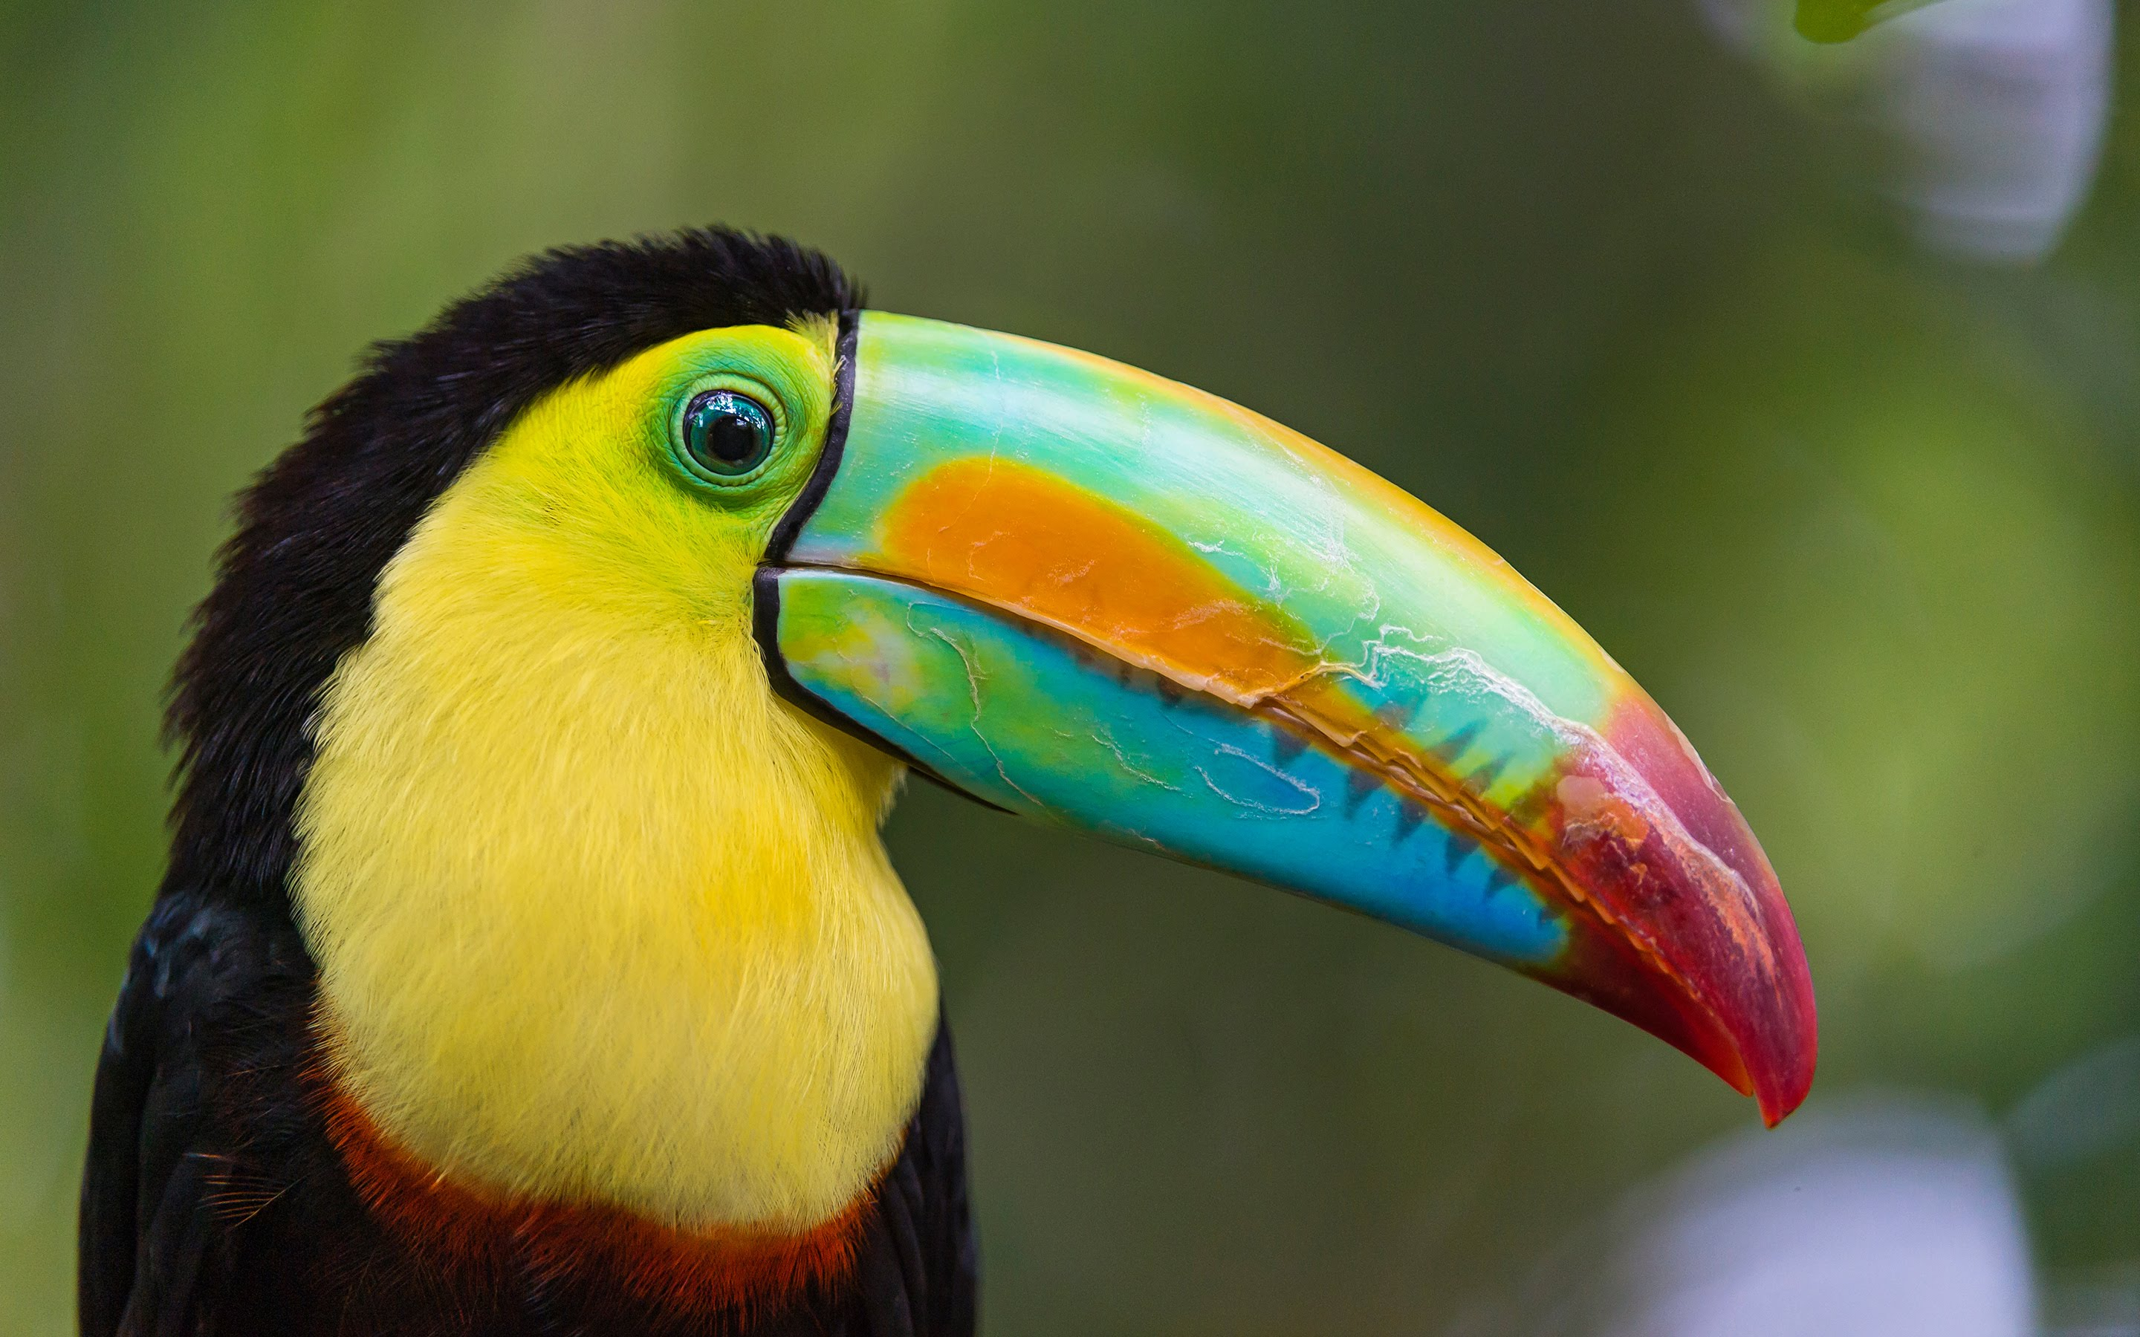
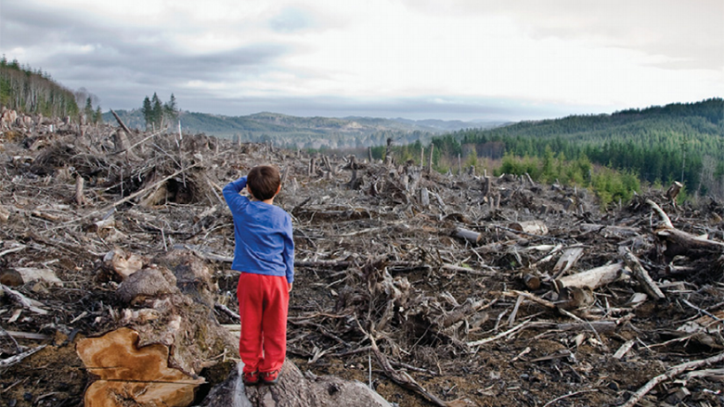
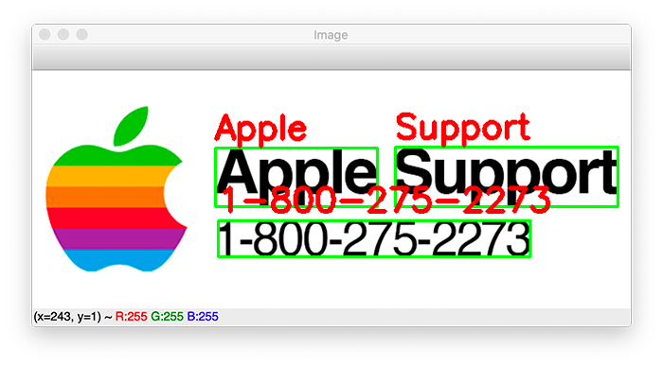
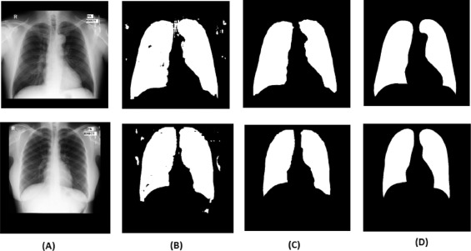
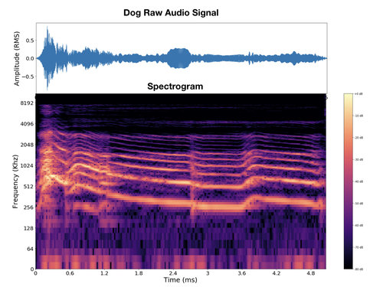
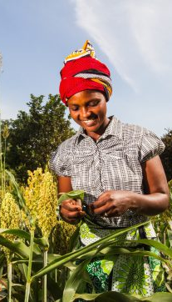


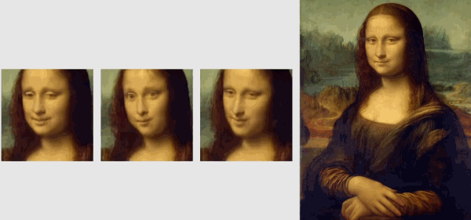
Background and Theories (20 min)
https://thispersondoesnotexist.com/
Notes:
Illegal logging

Slide 21
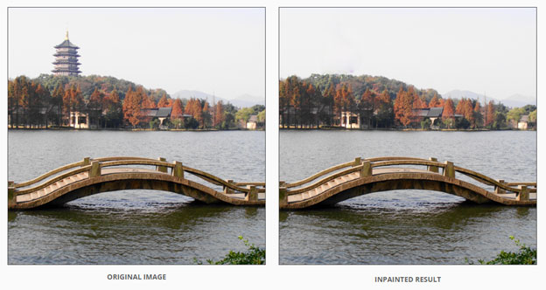
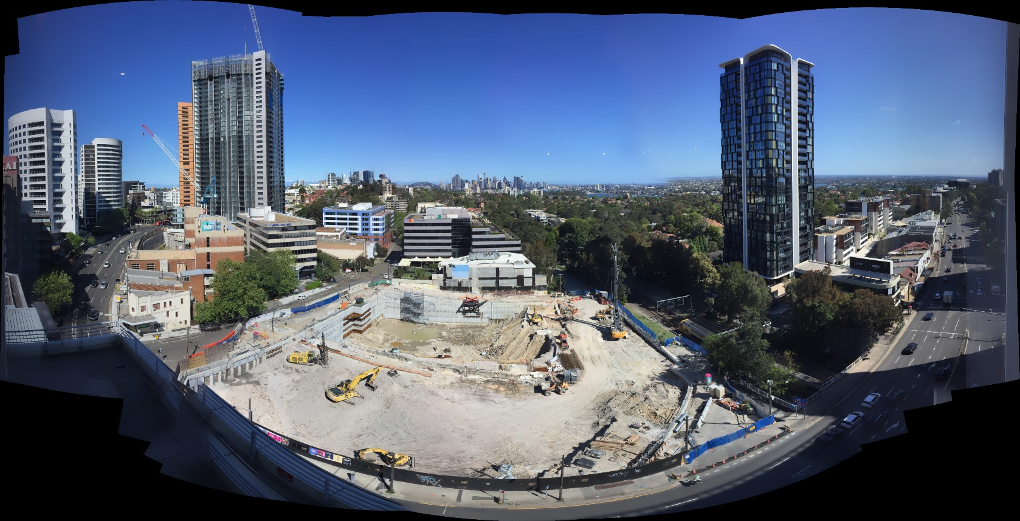
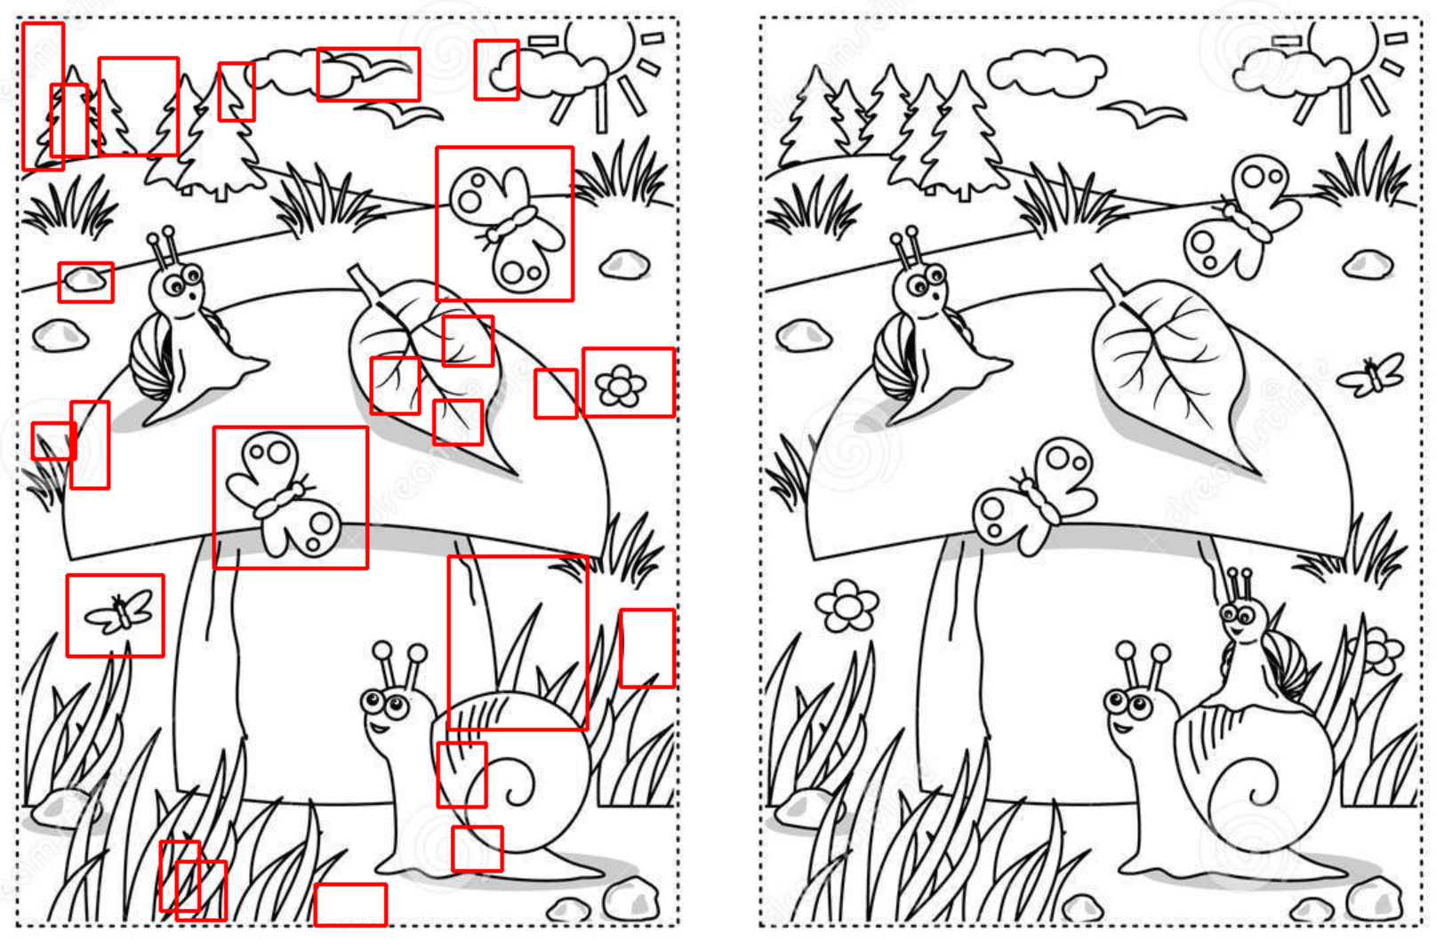
Background and Theories (20 min)

Slide 22
Coding Time (60 min refer to notebook)
Compare images, Restore images, Stitching images
Teaching points
Session specific
Read from path / file
Display photo / video
Display inline
Numpy
Resize, grayscale
Cropping, draw rectangle
threshold masking
findContours
cvtColor, filter
Export to file

Slide 23
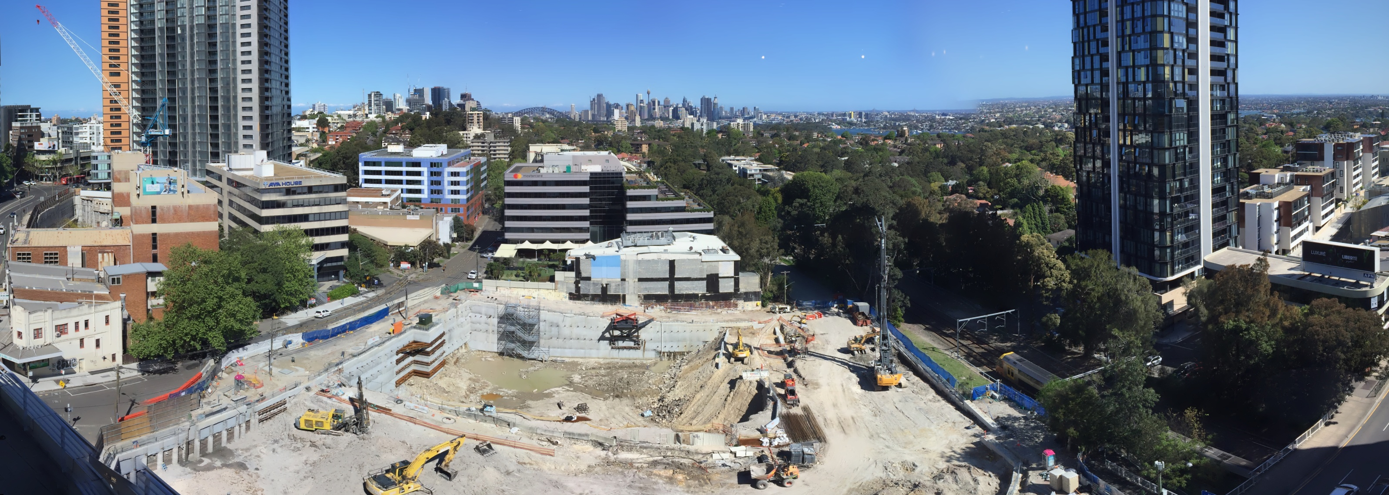
This Session Assignment
Define a function that can find prime number within any range (include docstring!)
Outline process of creating panorama
→
Notes:
Importance of identifying steps in coding process
Start to end many steps, seek answers to each step
Avoid trying to jump to final solution
Steps help debug “step by step”, can try out each step in jupyter
Only required to think of steps involved, use imagination
Full solution will be given next week for takeaway use

